Slide 1
Data Communication
Data Communications and Networking, 5th Edition
By
Behrouz A. Forouzan

Slide 2
Overview
Data Communication
Components
Data Representation
Data Flow

Slide 3

1. Data Communication
It is the exchange of data between two devices via a
transmission medium.
Communication system is a combination of hardware and
software.

Slide 4
Data Communication cont..
Effectiveness of data communication system is depends on four
fundamental characteristics:
Delivery
Accuracy
Timeliness
Jitter

Slide 5
Data Communication cont..
Delivery
System must deliver data to the correct destination.
Data must be received only by the intended device or user.
Accuracy
System must deliver the data accurately.
Data that have been altered in transmission and left
uncorrected are unusable.

Slide 6
Data Communication cont..
Timeliness
System must deliver data in a timely manner.
Data delivered late are useless.
Ex: Real-time transmission
Video and audio – Deliver it in the same order that they are produced, and without significant delay.

Slide 7
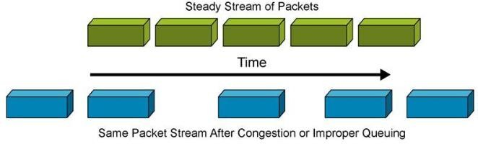
Data Communication cont..
Jitter
It refers to the variation in the packet arrival time.
It is the uneven delay in the delivery of audio or video packets.
Caused by network congestion and packet loss.

Slide 8
2. Components of Data Communication

Slide 9
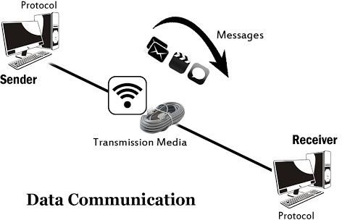
2. Components of Data Communication
A data communication system is made up of five components.
Message
Sender
Receiver
Transmission medium
Protocol

Slide 10
2. Components of Data Communication
Message
Information (data) to be communicated.
Ex: text, numbers, pictures, audio and video.
Sender
Device that sends the data message.
Ex: computer, workstation, telephone handset, video
camera and so on.
Receiver
Device that receives the message.
Ex: computer, workstation, telephone handset, television and so on.

Slide 11
2. Components of Data Communication
Transmission medium
Physical path by which a message travels from sender to receiver.
Ex: twisted-pair wire, coaxial cable, fiber-optic cable and radio waves.
Protocol
It is a set of rules that govern data communications.
It represents an agreement between the communicating
devices.
Ex: A person speaking French cannot be understood by a person who speaks only Japanese.

Slide 12
3. Data Representation

Slide 13
3. Data Representation
Information comes in different forms such as text, numbers,
images, audio and video.
Text
Numbers
Images
Audio
Video

Slide 14
3. Data Representation cont..
Text
Represented as a bit pattern, a sequence of bits (0s or 1s).
Different sets of bit patterns have been designed to represent text
symbols.
Each set is called a code.
Process of representing symbols is called coding.
Unicode
Common coding system.
It uses 32 bits to represent a symbol or character in any language.
American Standard Code for Information Interchange (ASCII)
Developed some decades ago in the United States.
Constitutes the first 127 characters in Unicode.
Also referred toDr.aC.sNABVANaEsETiHcANL,AaSStOiCnIAT.E PROF ,

Slide 15
3. Data Representation cont..
Numbers
Represented by bit patterns.
It is directly converted to a binary number.

Slide 16

3. Data Representation cont..
Images
Represented by bit patterns.
Composed of a matrix of pixels.
Each pixel is a small dot.
Size of the pixel is depend on resolution.
Better representation (resolution): more memory is needed.
Ex: Image can be divided into 1000
pixels or 10,000 pixels.
Each pixel is assigned a bit pattern.

Slide 17
3. Data Representation cont..
Images
Size and value of the pattern depend on the image.
1-bit pattern for image made of only black and white dots.
Ex: Chessboard
2-bit pattern for image is not made of pure white and pure black pixels.
Ex: 4 levels of gray scale
A black pixel can be represented by 00
A dark gray pixel by 01
A light gray pixel by 10
A white pixel by 11.

Slide 18
3. Data Representation cont..
Images
Several methods to represent color images.
RGB method
Each color is made of a combination of three
primary colors: red, green, and blue.
YCM method
Each color is made of a combination of three other primary colors: yellow, cyan, and magenta.

Slide 19
3. Data Representation cont..
Audio
Refers to recording or broadcasting of sound or music.
It is continuous, not discrete.
Video
Refers to recording or broadcasting of a picture or movie.
It can either be
Produced as a continuous entity (e.g., by a TV camera),
– or it can be a
Combination of images, each a discrete entity, arranged
to convey the idea of motion.

Slide 20
4. Data Flow or Transmission Mode

Slide 21
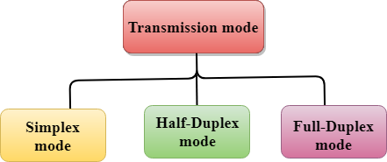
4. Data Flow or Transmission Mode
Defines the direction of signal flow between two connected
devices.
There are three modes of transmission, namely:
Simplex
Half-duplex
Full-duplex

Slide 22

4.1 Simplex Mode
Communication is unidirectional.
– Communication between sender and receiver occurs in only one direction.
Only sender can send the data and receiver can receive the
data.
Receiver cannot reply to the sender.
Use the entire capacity of the channel to send data.

Slide 23

4.1 Simplex Mode cont..
Ex: One-lane road
Ex: Keyboards and Monitors
Only Keyboard can send input to monitor
Monitor can only receive the input and display it on the
screen.
Monitor cannot reply to the keyboard.

Slide 24
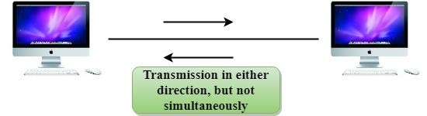
4.2 Half-Duplex Mode
Each station can both transmit and receive, but not at the same
time.
When one device is sending, the other can only receive, and vice versa.
Entire capacity of a channel is taken over by the transmitting device.

Slide 25
4.2 Half-Duplex Mode cont..
Ex: Walkie-talkies
Speakers at both ends can speak, but they have to speak one by one.
They cannot speak simultaneously.

Slide 26

4.3 Full-Duplex Mode
Also called duplex.
Both stations can transmit and receive at same time.
Signals going in either direction sharing the capacity of the link.
Sharing can occur in two ways:
Link has two physically separate transmission paths
One for sending and other for receiving.
Capacity of the channel is divided between signals travelling in both directions.

Slide 27
4.3 Full-Duplex Mode cont..
Ex: Two-way road
Traffic flowing in both directions at the same time.
Ex: Telephone network
Two people communicate
Both are free to speak and listen at the same time.

Slide 28
Comparison Chart
Basis for Comparison | Simplex | Half Duplex | Full Duplex
Direction of Communication | Unidirectional | Two-directional, one at a time | Two-directional, simultaneously
Send / Receive | Sender can only send data | Sender can send and receive data, but one at a time | Sender can send and receive data simultaneously
Performance | Worst performing mode of transmission | Better than Simplex | Best performing mode of transmission
Example | Keyboard and monitor | Walkie-talkie | Telephone

